Slide 1
PRAGMA19 – PRAGMA 20 Collaborative Activities
Resources Working Group

Slide 2

PRAGMA Grid/Clouds
UZH
Switzerland
UZH
Switzerland
CNIC
China
JLU
China
AIST
OsakaU
UTsukuba
Japan
KISTI
KMU
Korea
IndianaU
USA
LZU
China
SDSC
USA
LZU
China
ASGC
NCHC
Taiwan
HKU
HongKong
UoHyd
India
ASTI
Philippines
NECTEC
KU
Thailand
CeNAT-ITCR
Costa Rica
From PRAGMA 19 to PRAGMA 20
VM sites from 4 to 9
SDSC, AIST, NCHC, OsakaU,
IndianaU, USM-CS, ASTI, MIMOS, LZU
VM applications from 1 to 6
SDSC: Avian Flu Grid, Autoduck, Blast
AIST: Bloss, Geogrid
NCHC: F-Motif
HCMUT
HUT
IOIT-Hanoi
IOIT-HCM
Vietnam
MIMOS
USM
Malaysia
MU
Australia
BESTGrid
New Zealand
UChile
Chile
26 institutions in 16 countries/regions, 22 compute sites, 9VM sites (+ 6 site in preparation)

Slide 3

VM Migration and Interoperation Successful http://goc.pragma-grid.net/wiki/index.php/Virtualization
AIST (Rocks)
3 Experiments, 5 applications
Bloss, Geogrid (AIST)
F-Motif (NCHC)
Autoduck, Blast (SDSC)
Condor
Condor
BIO
GEO
EC2
Easy migration
Only a few changes required
Hostname, IP, Gateway
For different platforms, attach compatible kernel module
Can be automated
GEO
GEO
BIO
Condor
Condor
BIO
NCHC (KVM)
SDSC (Rocks)

Slide 4
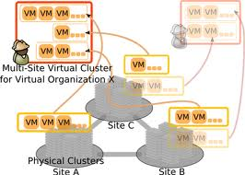




More Work in Clouds
Easy extention of Cloud resources
Successfully built multi-site Rocks virtual cluster (OsakaU)
Easy extention with VM+Condor (SDSC, GLEON, Condor)
Successfully completed phase 1 of 4
Cloud middleware
Sigiri/Opal interface to easily enlist Cloud resources (IndianaU, USA)
Easy VM user interface and tools
Pilot - enable users full control Rocks VMs from laptops (SDSC)
EC2
VM
Pilot
Rocks-based Clouds

Slide 5

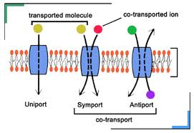
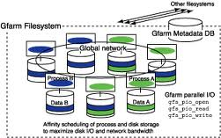
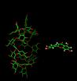


Grid Applications, Data Storage and Collaboration tools
Applications
NG-TEPHRA/Nimrod (ITCR, Costa Rica; MU, Australia)
Improved code
Ran 98k scenarios
Automated workflow
Published results in an IEEE paper
Membrane transport (LZU, China)
Completed molecular dynamic simulation
A paper has been submitted for publication
LindaX development on-going (HUT, Vietnam)
Parallel programming system
Easy user interface
Mgrid (KookminU, Korea)
Continue develop, deploy and test
Getting ready to serve 7 Korean institutions and PRAGMA
Gfarm enhancement (UTsukuba, Japan)
Auto-replication, Samba plugin, Hadoop plugin
Collaboration tools
Duckling (CNIC, China)
Continuing develop and enhance
Used by PRAGMA workshops since PRAGMA 18

Slide 6
Resources in PRAGMA20
Thursday 14:00-15:00
demo and discussion of VM issues
Rehearsal by Phil, Yoshio, and Cindy
have a presentation by Kokubo-san (Osaka U)
Towards A Virtual Cluster over Multiple Physical Clusters Using Overlay Network

Slide 7
Resources in PRAGMA20
Friday 11:00-12:15
discussion of collaboration with HK team
invite some talks from HKU
Dhun-Ho Liu, Morris Law, Kwan Wing Keung, Cho-Li Wang
Learn what had been done and what is happening in HK.
Followed by discussions in the afternoon
Friday 14:00-15:00
have presentations by Tran Vu Pham (HCMCUT) and Hiroki Ohtsuji (U. Tsukuba)
VN-Grid Project: Results and Remaining Challenges
Optimization of Remote File Access Considering Access Pattern and Network Delay
summary and figure out of action items for PRAGMA21.

Slide 8
Works by PRAGMA21
VM issues
Supporting cluster environments
E.g. Condor (as a batch scheduler) + MPI
Expand three sites to more
IU, ASTI, Monash, Osaka, Tsukuba
TBC: LZU, MIMOS, USM,
Create their own VM images
Start with F-Motif and Bloss
VM repository to share VM images
Use Gfarm as back end
Deploy Gfarm at San Diego by the end of March
San Diego, AIST, Tsukuba
From prototyping to production
What is the real scenario?
Contribution by HKU
Live migration on PRAGMA?
Possible collaboration between HKU and AIST
Start Beginning of May
Start with HK, JP, US

